Slide 1
Introduction to Advanced RAG: Enhance Your Retrieval-Augmented Generation
By: Satyajeet Narayan Co-founder: thedotproduct.in

Slide 2
What LLMs can do?
LLMs excel at processing and generating human-like text, enabling applications like chatbots, content generation.
They can perform logical reasoning and problem-solving to some extent, particularly in structured tasks and can also produce creative outputs
LLMs can generate answers based on the information encoded in their training data.

Slide 3
The need for a new technique
Limited Knowledge Base of Generative Models:
Pre-trained large language models (LLMs) like GPT-3 or Llama are limited by their training data.
Hallucination in Generative Models:
Generative models often "hallucinate" facts, creating plausible but false information because they rely on patterns in training data rather than verified sources.

Slide 4
What is RAG?
RAG (Retrieval-Augmented Generation), a technique that combines retrieval-based methods with AI models to produce more accurate, relevant, and informed responses. It's widely used in tasks where large knowledge bases, documents, or other external data sources are involved, such as question-answering, summarization, and content generation.

Slide 5
Problems that RAG solved
Inefficiency of End-to-End Retrieval Systems:
Traditional retrieval-based systems return raw documents or text snippets but don’t generate natural language explanations or summaries.
Flexibility in Domain Adaptation
Fine-tuning LLMs to incorporate domain-specific knowledge is expensive, time-consuming, and often infeasible when the knowledge changes frequently.
RAG addresses critical issues in scalability, factuality, flexibility, and efficiency by integrating the best of both worlds: retrieval and generation. It enables systems to dynamically incorporate external knowledge, reduce hallucinations, improve accuracy, and provide traceable outputs, making it indispensable for modern AI applications.

Slide 6
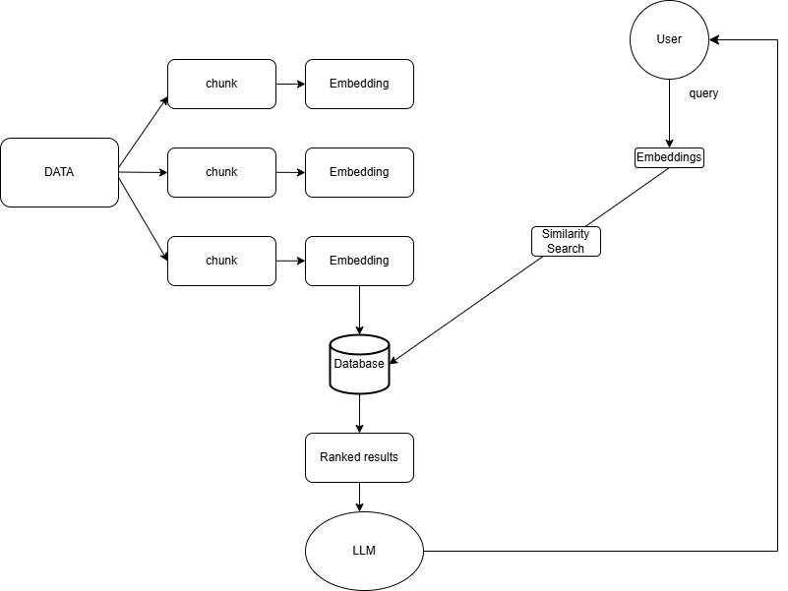
The RAG Architecture

Slide 7
Let’s code a simple RAG

Slide 8
Why does chunk size matter
LLMs have a fixed maximum token limit and feeding input chunks larger than this limit results in truncation, losing critical information.
Small Chunks loose context because the relationship between adjacent chunks may not be preserved but larger chunks retain more context but risk exceeding token limits or being harder for the model to process efficiently.
Chunking impacts how data is indexed for semantic search. Smaller, focused chunks result in more accurate embeddings for retrieval.
Every embedding model has a limit on the number of tokens (or characters, depending on the model's design) it can process in a single pass. The size of a chunk should not exceed this limit to ensure that the embedding model processes the text correctly and generates meaningful embeddings.

Slide 9
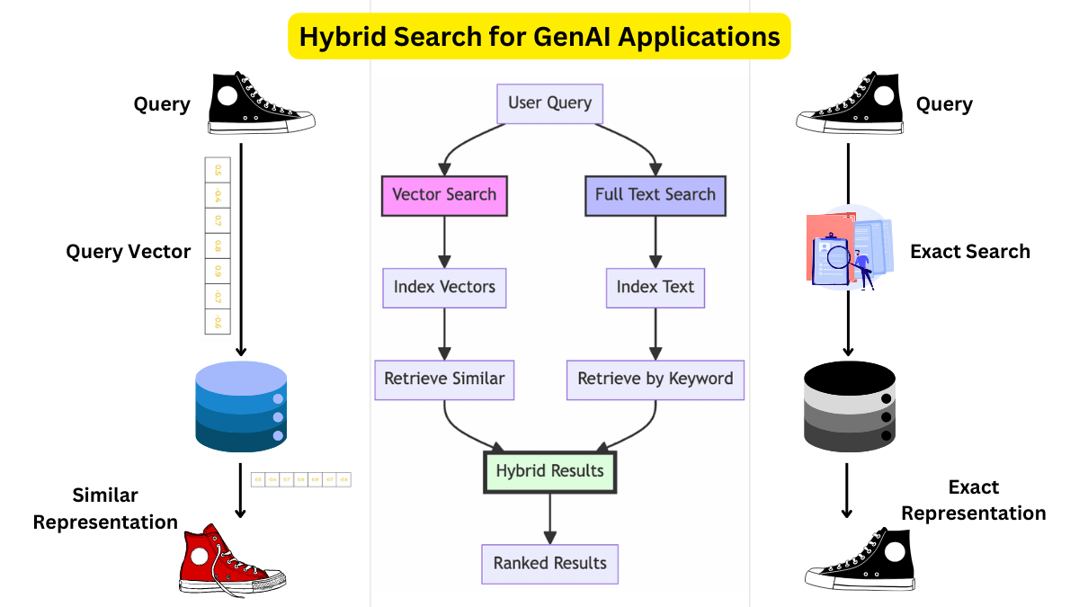
Hybrid Search: The Architecture?

Slide 10
Hybrid Search: The What?
Hybrid search is the combination of having a keyword style search and a vector style search.
In the user’s query we ;look for keywords and then we do a keyword based search with all the chunks that are available
It uses both a sparse matrix and a dense matrix for keyword based lookup and semantic lookup respectively.

Slide 11
Hybrid Search: The Why?
Keyword Search alone fails to retrieve contextually relevant results if synonyms or rephrased terms are used.
Vector Search alone can sometimes retrieve less relevant results for niche terms or noisy embeddings.
Keyword based search: Excels in retrieving exact matches for well-defined terms, acronyms, or specific phrases. It ensures precision when users use specific jargon or terms.
Vector Search: Uses semantic understanding to find contextually or conceptually similar information, even if the exact keywords aren't present in the query.
Keyword Search: Works well with structured text and metadata, ensuring retrieval from index fields like titles, tags, or document metadata.
Vector Search: Handles unstructured or incomplete text by using semantic embeddings to infer meaning and locate relevant passages.
Results can be sorted to prioritize exact matches (keywords) while also including semantically related results (vectors).

Slide 12
Hybrid Search: The When?
When using domain specific documents: like medical, legal, Product Discovery or research papers.
Medical:
Keyword search ensures retrieval of specific medical terms (e.g., "metformin dosage").
Vector search allows querying in natural language (e.g., “What is the treatment for Type 2 diabetes?”).
Legal:
Keyword search retrieves clauses or sections with exact terms (e.g., "indemnity clause").
Vector search finds semantically similar content (e.g., variations of confidentiality clauses across documents).
Product Discovery:
Keyword search ensures precision for product codes or exact names.
Vector search helps with vague or descriptive queries (e.g., “comfortable office chairs under $200”).
Research papers:
Keyword search pinpoints specific references or citations (e.g., "Einstein 1915 General Relativity").
Vector search retrieves semantically related papers or studies, even if terminology differs.

Slide 13
Hybrid Search: The Disadvantages?
When should not be used:
When the data is small or homogeneous: Hybrid RAG's complexity isn’t necessary when datasets are small or contain highly similar content, as keyword or vector search alone might suffice.
Real time streaming data: Hybrid search isn’t optimized for streaming data that changes rapidly, where real-time indexing is a challenge.
Poor user query: If user queries are poorly phrased or ambiguous, hybrid search might return irrelevant results due to overgeneralization in vector search.

Slide 14
Let’s code a Hybrid Search

Slide 15
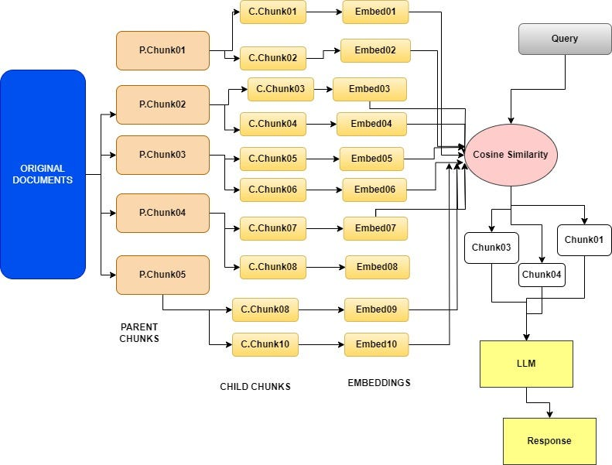
Parent Document Retriever: The Architecture?

Slide 16
Parent Document Retriever: The What?
A Parent Document Retriever in Retrieval-Augmented Generation (RAG) is a specialized approach to retrieval where documents are hierarchically organized, and the system focuses on retrieving a "parent document" or a high-level context, which may contain or relate to the information needed to answer the query, ensuring a broader, contextual overview is provided rather than fragmentary or isolated results.

Slide 17
Parent Document Retriever: The Why?
When documents are broken into smaller chunks (e.g., paragraphs or sections), retrieving isolated fragments can lead to a loss of context. This can cause the RAG system to generate irrelevant or incorrect responses. A parent document retriever fetches the larger context (e.g., the entire document or a high-level section) to ensure that smaller chunks are interpreted correctly.
Generative models can hallucinate or misinterpret information when provided with insufficient context. A parent document retriever ensures the LLM has access to a richer context, reducing the risk of hallucinations.
Works well when dealing with massive datasets where computational efficiency matters.

Slide 18
Parent Document Retriever: The When?
When the query requires understanding a broader context before answering, especially if smaller chunks alone might lead to ambiguous or misleading responses. A parent document provides a holistic view that ensures coherence and relevance in the response.
When isolated chunk retrieval results in irrelevant or out-of-context fragments being retrieved, hallucinations can occur. Retrieving the parent document narrows the focus and reduces noise, ensuring only relevant parts are processed.
When the goal is to summarize large documents or provide a high-level overview before diving into details. Retrieving a parent document ensures the entire context is available for summarization.
When building systems that need to answer questions accurately and robustly from large document repositories. Parent document retrieval ensures answers are based on comprehensive information.

Slide 19
Parent Document Retriever: The Disadvantages?
Retrieving and processing entire parent documents can be more resource-intensive compared to retrieving smaller chunks. This can lead to higher memory usage and slower response times, especially with large datasets.
Parent documents often contain more information than required, including irrelevant sections, leading to noise. The RAG system might need additional steps to filter out irrelevant parts, increasing complexity.
Parent document retrieval might overlook the precise relevance of smaller chunks within the document. This could result in less specific answers if the system focuses too much on the broader context.
Large parent documents may exceed the input token limit of the language model, requiring additional truncation or summarization. This can lead to loss of critical information or incomplete answers.
If multiple queries target different parts of the same parent document, retrieving it repeatedly can lead to redundant operations. This inefficiency can slow down the system in batch or multi-user environments.

Slide 20
Let’s code a Parent Document Retriever

Slide 21
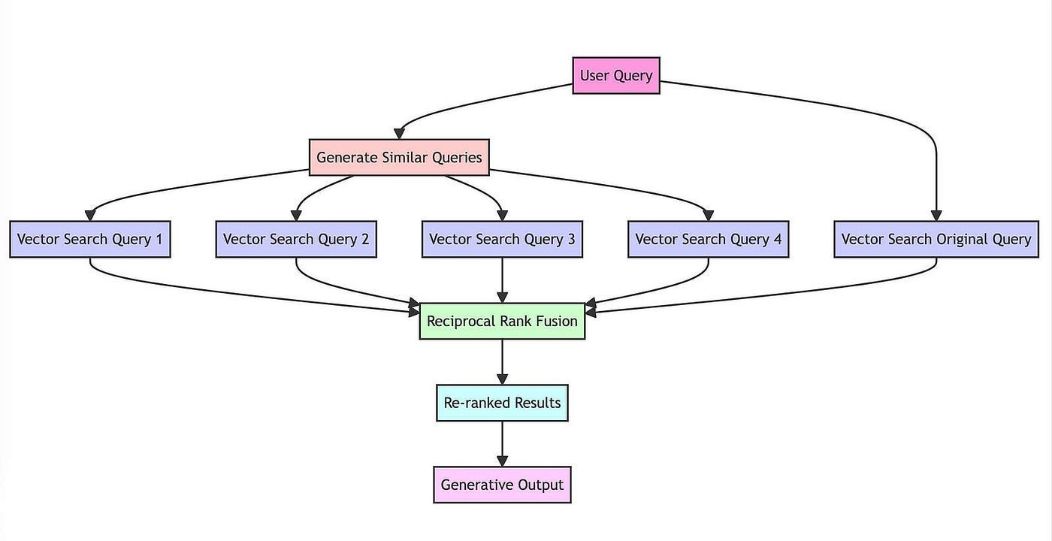
RAG Fusion: The Architecture?

Slide 22
RAG Fusion: The What?
Multiple sub-queries are generated from the user’s query.
These sub-queries may target different aspects or dimensions of the main query to ensure comprehensive coverage.
Each subquery is used to retrieve relevant documents or chunks from the knowledge base.
The retrieved results are then reranked and passed to the LLM

Slide 23
RAG Fusion: The Why?
The user might ask vague questions and the similarity search might not fetch relevant documents and hence we generate more queries,which captures diverse aspects of the original query that will potentially enhance our similarity search.
Ranking and fusing results help filter out irrelevant or redundant information, improving the quality of the input to the LLM.

Slide 24
RAG Fusion: The When?
Queries requiring analysis across multiple dimensions or domains.
Summarizing or answering queries from detailed documents like research papers, manuals, or contracts.
Where multiple sources or diverse pieces of information are needed for accurate responses.
When the user needs a multi disciplinary answer for his or her query.
When the user can ask simple and vague queries.

Slide 25
RAG Fusion: The Disadvantages?
Generating and processing multiple sub-queries increases retrieval and ranking costs.
Requires robust query generation and ranking mechanisms to work seamlessly.
Results from different sub-queries might overlap or conflict, requiring sophisticated ranking and filtering.
Reranking adds steps to the pipeline, potentially increasing response time, which may be problematic for real-time systems.

Slide 26
Reciprocal Rank Fusion
Reciprocal Rank Fusion (RRF) is a technique for combining the ranks of multiple search result lists to produce a single,
unified ranking. Developed in collaboration with the University of Waterloo (CAN) and Google.

Slide 27
Let’s code a RAG Fusion

Slide 28
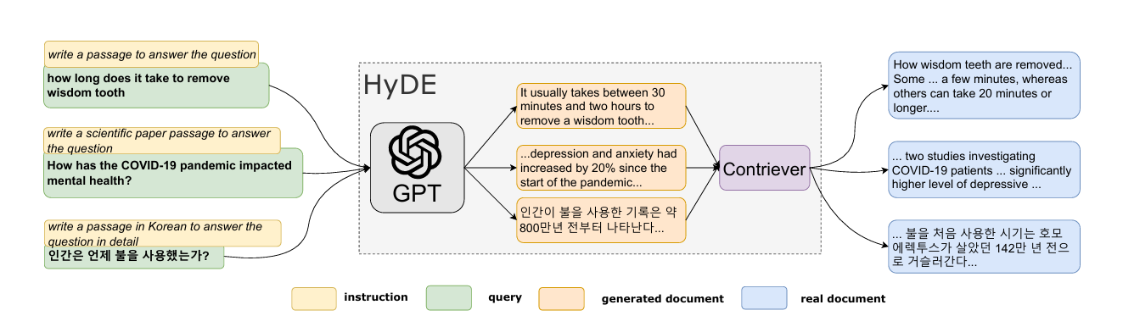
HyDE: The Architecture?

Slide 29
HyDE: The What?
HyDE (Hypothetical Document Embedding) is a retrieval-augmented generation (RAG) technique designed to enhance the performance of retrieval systems, especially for cases where queries are vague, ambiguous, or lack sufficient context.
It involves generating hypothetical (synthetic) answers based on the query and then using these answers to guide the retrieval process.

Slide 30
HyDE: The Why?
For poorly specified queries, the hypothetical document provides much-needed context, improving the relevance of retrieved results.
By generating an ideal response, HyDE ensures retrieval aligns closely with the user's intent.

Slide 31
HyDE: The When?
When the user's query is too short, lacks clarity, or can be interpreted in multiple ways.
When the query requires retrieving diverse or broad content.
When the query lacks specificity or critical details.
For technical, academic, or legal queries where domain-specific context is essential.
For queries that inherently require breaking down into multiple components or perspectives.

Slide 32
HyDE: The Disadvantages?
If the query is already specific and well-structured, generating hypothetical documents may add unnecessary computational overhead.
The additional step of generating hypothetical documents may introduce unacceptable delays.
If the generative model produces poor or biased hypothetical documents, it can negatively affect retrieval quality.
A fine tuned model is preferred
For queries that inherently require breaking down into multiple components or perspectives.

Slide 33
Resources:
Everything You Need to Know About Chunking for RAG
The Power of Chunking: Why Text Chunk Size Matters in Leveraging Large Language Models for RAG Systems Reciprocal Rank Fusion paper

